Slide 1
Josh Titley
Business Solutions Manager

Slide 2

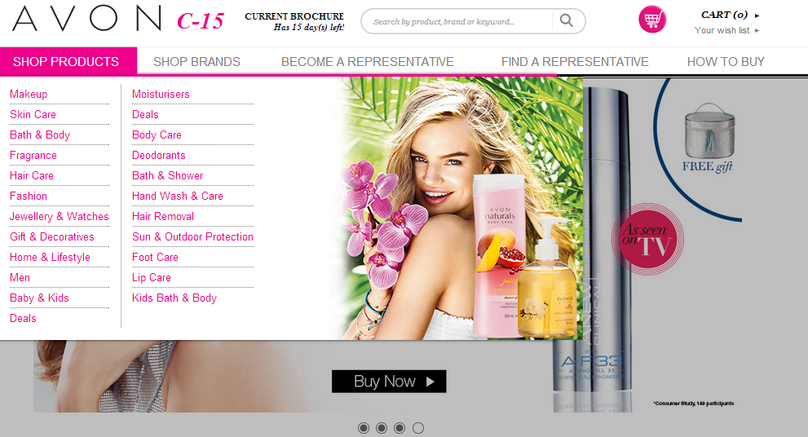
Title Here Capitalize Each Word
Agenda
Why DCE Direct Delivery?
Things to Consider
ANZ Learnings

Slide 3
Title Here Capitalize Each Word
Agenda
Why DCE Direct Delivery?
Things to Consider
ANZ Learnings
Preliminary Results

Slide 4



ANZ DCE Update
Why DCE?

Slide 5
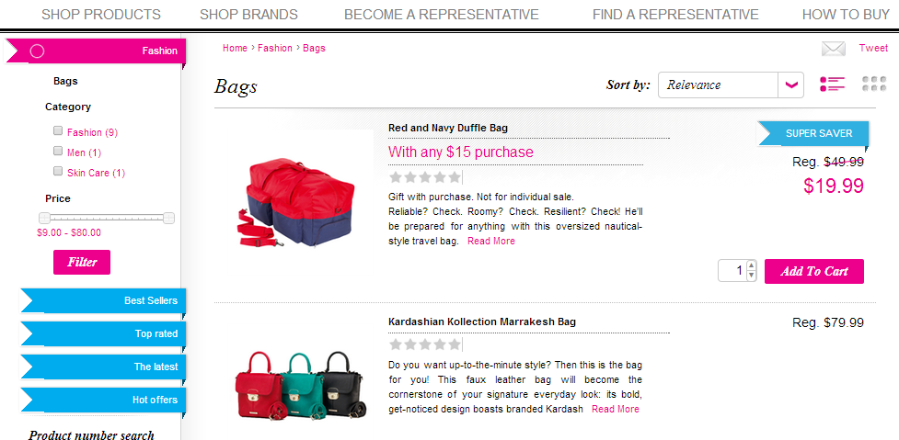
ANZ DCE Update
Why DCE Direct Delivery?
New channel for Customers
Keep Stranded Customers
Attract Customers who do not want a Representative
Upgraded experience over vBrochure
Potential to be CRM and ALM Replacement
Modern fresh look
Notes:
For ANZ DCE Direct Delivery was about opening up a new channel for Customers. It was recognized that not all Customers appreciate the value that Representatives deliver and “just want the product”. DCE Direct Delivery was a way to capture these incremental Customers yet not disadvantage the Representative. We will get into more specifics on that later.
Stranded Customers was another issue for us and DCE was a way to ensure that if a Representative leaves Avon, the Customer can still purchase.
It’s hard to accept but for ANZ 50% of Representatives are really Customers. They joined because it is the only way to get access to the Avon brand of products. DCE Direct Delivery can attract these kinds of Customers who “just want the product”
In all honesty the vBrochure experience isn’t the great. It wasn’t particularly well received, even though for a whilst ANZ was the top user of vBrochure. DCE represents in a way an advanced version of vBrochure and we are seeing signs that this is how some Customers view DCE.
We recognize that the DCE has the potential to be a Representative CRM and ALM Replacement. Ironically enough we recognized this much earlier on before knowing about the future direction of DCE will include ALM-like features. It’s interesting to note that a 3rd party tool called AvonCRM is used here in Australia and we are frequently “at odds” with it. Our top Representatives are passioniate about this tool as a contributor to their success. We hope that as DCE evolves with it’s own functionality AvonCRM customers will migrate to our tool.
Lastly, we loved the modern look and feel of the website and acknowledge it is a much better experience than GI3 and eBrochure. The DCE platform is a great platform with heaps of potential for a great experience for both Customers and Representatives.

Slide 6
ANZ DCE Update
Things to Consider

Slide 7

ANZ DCE Update
Things to Consider
Customer CRM
Fulfillment System
Compensation Model
Products/Promotions
Financial (Charging/Refunding)
Notes:
So I will cover 6 areas that you must consider before going down the direct delivery route. Customer CRM, Fullfillment system, compensation model, products/promotions, finances, and cloud hosting. These areas also represent the heart of the challenges we faced when implementing direct delivery.

Slide 8
ANZ DCE Update
Things to Consider
Customer CRM
Fulfillment System
Compensation Model
Products/Promotions
Financial (Charging/Refunding)
Cloud Hosting
Notes:
So I will cover 6 areas that you must consider before going down the direct delivery route. Customer CRM, Fullfillment system, compensation model, products/promotions, finances, and cloud hosting. These areas also represent the heart of the challenges we faced when implementing direct delivery.

Slide 9

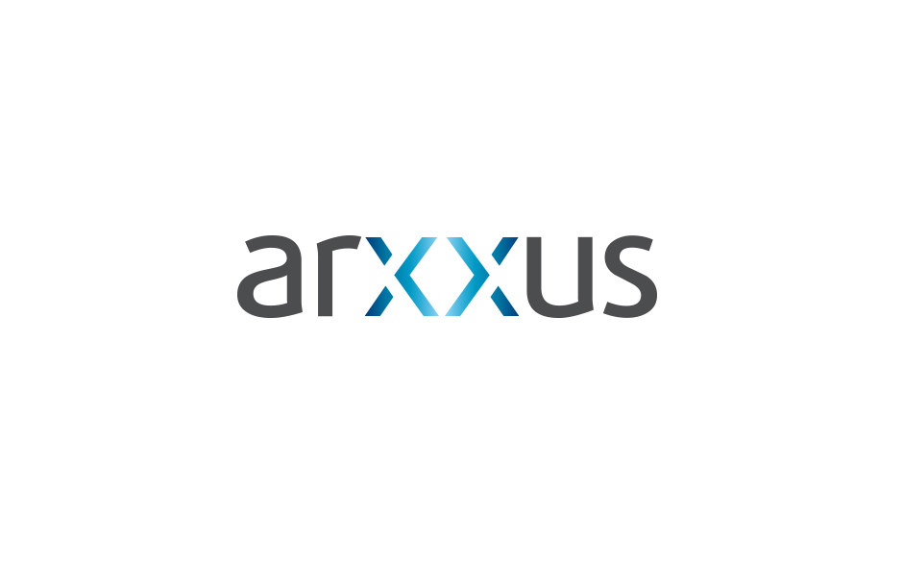

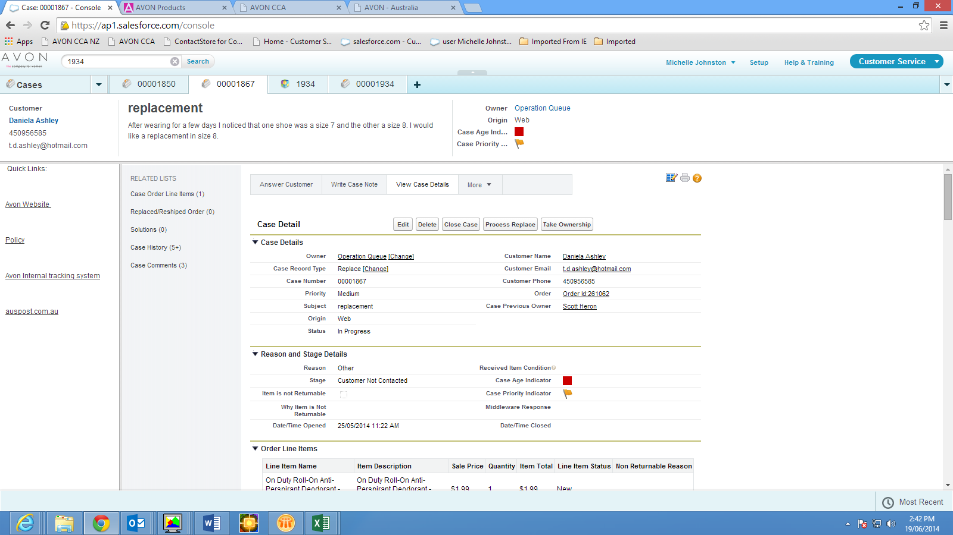
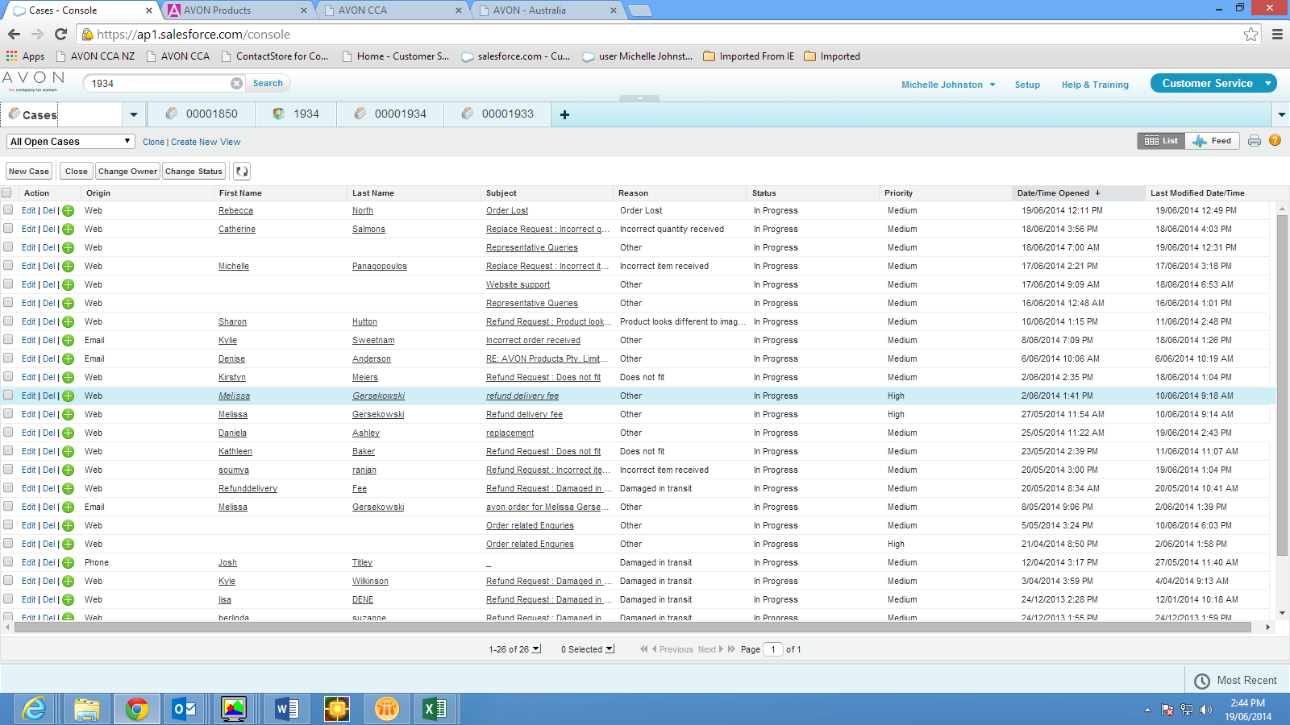
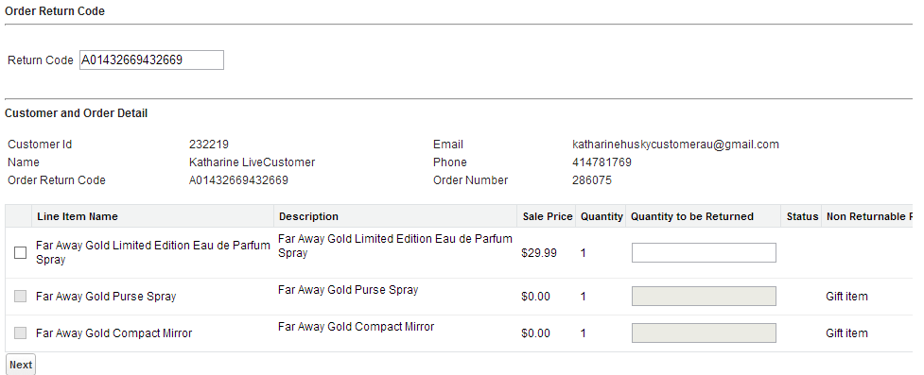
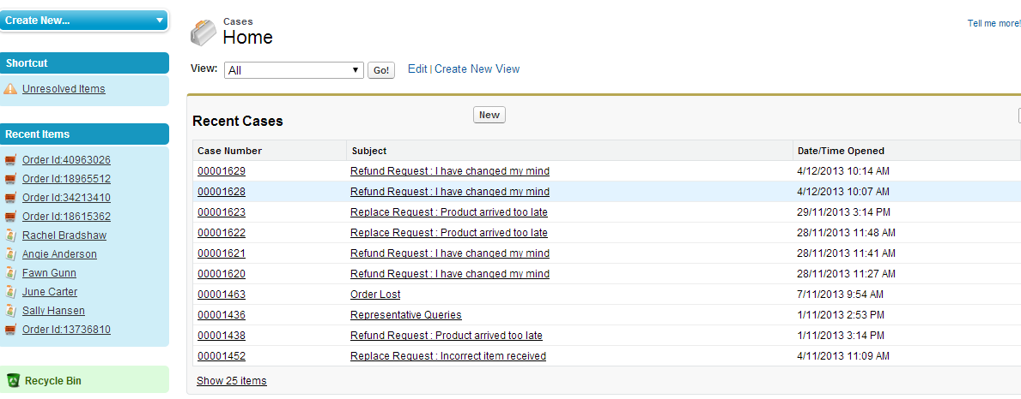
Things to Consider
Customer CRM
Your existing system may not support Customer
data
Australia created a new CRM using SFDC
Includes Customer facing refunds forms
Case management on any issue
Payment gateway integration for
refunds
Could be integrated into other
markets
SFDC experience extremely positive
Notes:
Australia’s CRM certainly does not support Customers, being solely tailored for Representatives. Additionally we simply did not have the time to revise or create a new CRM to manage customers. As such we had to find an alternative solution.
Leveraging the ideas of project Agile, Arxxus a SalesForce owned vendor was commissioned to develop a Customer Service platform for DCE.
It includes Customer facing return/refund forms. Not only does it know about existing orders but is intelligent to know what is refundable and when to escalate to managers. Upon final approval, a call to the backend is made to authorise the refund.
The CRM also supports case management. It is a concise, logical way to manage Customer queries so that nothing is missed. We haven’t leveraged all the features due to cost but Salesforce can link into Social Media and PBX systems to create a unified experience.
Customer Service can also initiate refunds for any reason. SalesForce has a flexible workflow system to account for approvals and once approved, refunds are submitted to the backend.
Our implementation is pretty generic so it would be feasible to integrate with other markets. We had nothing but a positive experience with SalesForce and Arxxus and would recommend this solution. Having said that I’m sure Finance would disagree as it is costly to maintain, roughly $2K USD per user per year. However I think it is justified as Customer Service productively is much better for Avon Online then with our traditional Representative system.

Slide 10
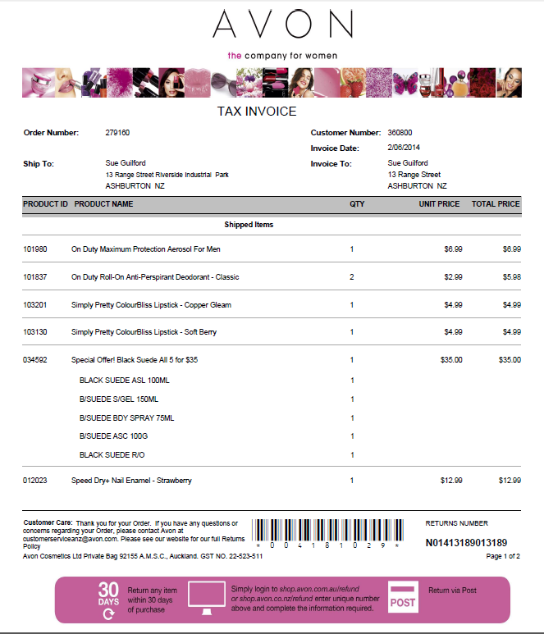
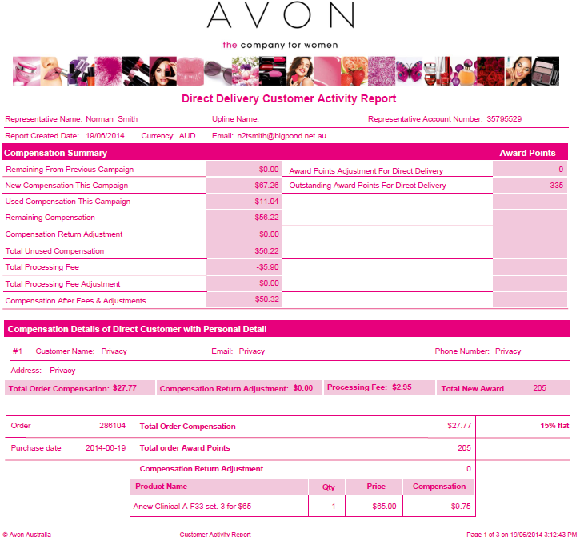
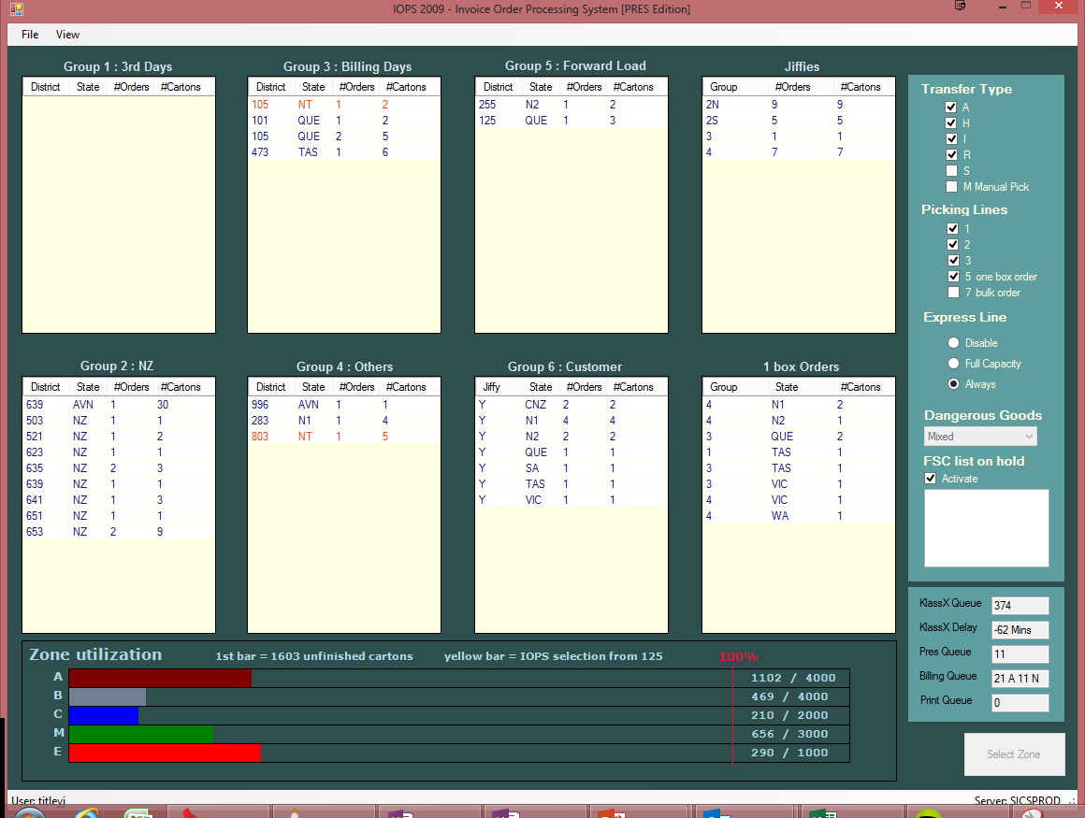

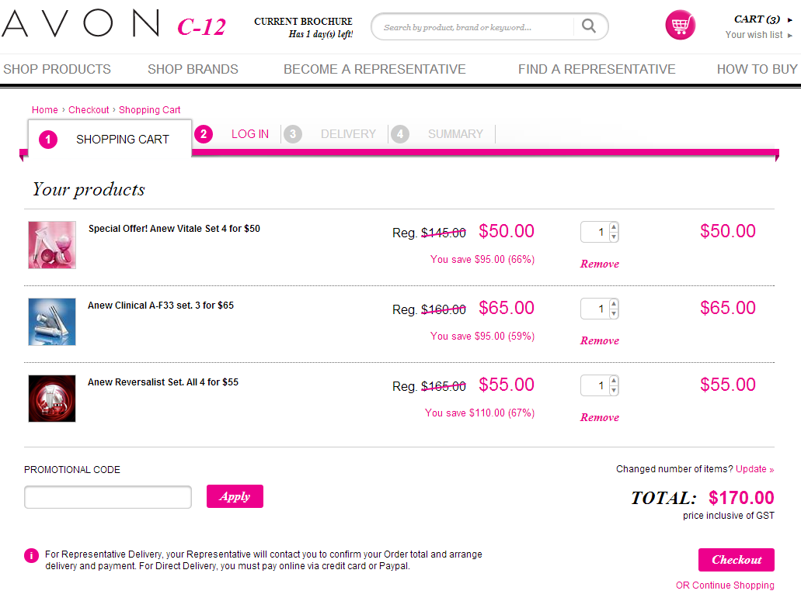
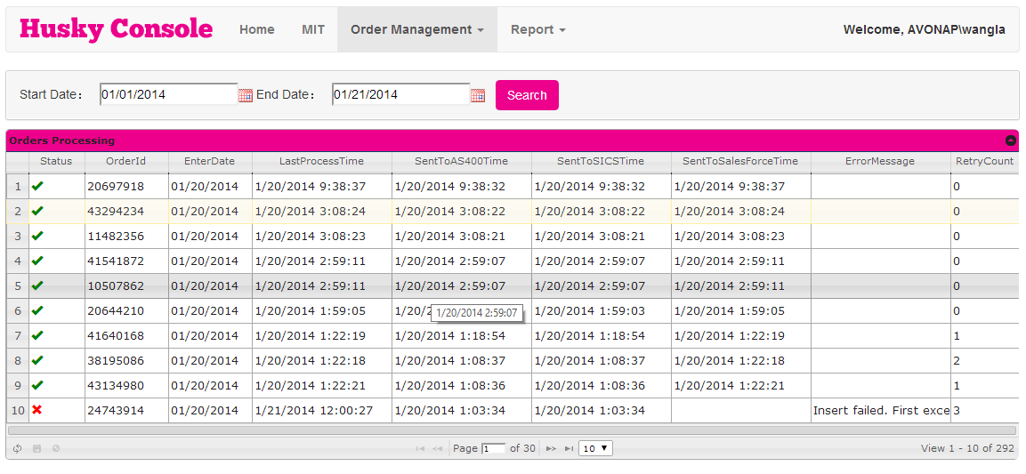
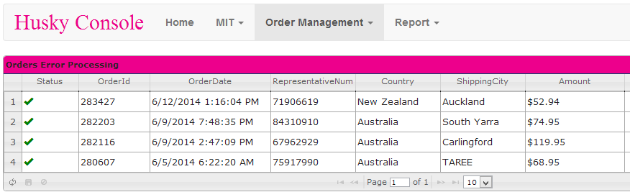
Things to Consider
Fulfillment System
Does your system support Customers?
Customer orders are prepaid – No
billing
Shorts are automatically refunded
Compensation calculations requires reporting
Order Management – Handling errors
Invoices Need To Be Created
Notes:
Change to fulfillment are huge. And I suspect each market will have vastly different requirements. For us we simply did not support customers so we had to find a way to “shoehorn” this data into existing systems.
Additionally Customer orders are prepaid, not post-pay. So you now have to worry about shorts and refunds. In fact refunding which was quite a rare event with Representatives now becomes the norm, both operationally and with Customer Service. In our case when we complete picking we will automatically refund shorted items. This is not as easy as it seems when you have to consider offers. In fact managing DSI offers, which are not the same as Gomac offers, was almost a small project in itself.
Depending on how you plan to compensate Representatives, you will probably need reporting. We had to develop a similar report to leadership in order to reflect how compensation is calculated. Our model is not straightforward since it depends not just on Representative profit levels, but also if the Customer wants contact. Since we also reflect refunds we had to devise a rather intricate report.
One thing that came obvious was order management. DCE itself is not sufficient to validate and verify business rules. So before passing orders to our backend we had to create a mini OMS. It’s job is to ensure data is correct. For example FSC’s and line numbers in all systems, offers are valid, no po boxes, districts can be determined from addresses, compensation Representative has been passed, order value matches charged value, etc. This has proven invaluable to us because it keeps the orders clean when we process but it also empowers the business when item data has issues. I don’t know about other markets but for Australia our IT spends a significant amount of time dealing with billing errors. With this model we spend no time. The reason is we halt orders when we detect this and the business must amend before it continues.
Lastly we had to create invoices. Don’t underestimate the effort to do this. The DSI order interface has issues and a lot of reverse engineering went into ensuring that the information provided could render into a nice friendly invoice. At present we know some offers are not correct in the fulfillment interface but until we do full regression testing we won’t use them. Likewise we cannot use coupons at the moment because this information is not passed back. Again, make sure you allocate enough development and test time on this because it is quite tricky.

Slide 11

Things to Consider
Compensation Model
Legal implications
Don’t disadvantage the Representative
Pay now or discount personal order?
IBO or Customer?
Full Commission
Contact or No Contact?
Discounted Commission
Compensation!
Extended Volume Discount
Commission is taxable
Hard or Soft attach?
Meet Fair Trade Laws
Service Fee
Flat Commission
Notes:
The compensation model requires substantial guidance from legal and careful analysis to ensure that the Representative is not disadvantaged and that Avon main margin and profit. There is always a risk that Customers migrate and instead we are inadvertently diluting the bottom line. Each Market will have specific legal concerns but be careful of the relationship between Customer and Representative. In Australia legal reasons required us to not pay commission, but to “compensative” Representative accounts with an applicable discount. In our model Representatives are compensated full profit, less a per customer administration fee. This allowed us to avoid paying tax on Representative earnings. Customers still are charged for shipping. Representatives are still compensated if the Customer does not elect communication, albeit at a reduced flat rate of 15%.

Slide 12
Things to Consider
Compensation Model
Legal implications
Don’t disadvantage the Representative
Australia’s model
,
Australia’s Model
Compensation not commission
Full compensation based on Representative profit level
No contact is flat 15%
Each Customer attracts a $2.95 service fee on Representative order
No service fee if compensation under $2.95
Compensation on returns deducted
Notes:
For Australia’s model compensation is not the same as commission. This is a legal distinction because commission will trigger a taxable transaction.
We offer full compensation at the Representatives profit level. If a Customer doesn’t want a Representative some lucky Representative will get a flat 15%. Note our new MD is questioning this and we may move to paying no commission in this case and re-investing compensation into Marketing.
We also charge $2.95 Customer fee. This is something we discovered Mary Kay was doing and thought it was a good idea. Of course if compensation is under $2.95 we don’t charge any fee.
Lastly if a Customer returns products we will deduct this compensation from a Representative. Now we don’t do anything if it is already spent so it is entirely possible for the Representative to have a negative compensation balance but we have yet to see this.

Slide 13
Things to Consider
Compensation Model
Legal implications
Don’t disadvantage the Representative
Australia’s model
Legal approval critical and potentially complicated - start immediately!
Notes:
Legal approval is critical and potentially complicated. Start now to avoid delays because it is a minefield of issues.

Slide 14
Things to Consider
Products/Promotions
Complex promotions or are aligned with Gomac?
DCE supports mailplans but consider impact
DCE pricing not Gomac, budget FTE
Impact of online only promotions
Limited Product availability
Minimise shorts and products or show all?
Campaign testing
Notes:
Products and promotions. DCE is not Gomac. Which means if you are not aligned you are going to have problems. This is precisely what we found. I suspect if you are already using DCE you have gone through this exercise of promotion alignment but it bears repeating. For Australia we still aren’t willing to be 100% aligned, something I personally disagree with. However the impact so far is minimal and I expect refined alignment as campaigns move forwards.
DCE supports mailplan but consider the impact if you are a mailplan market. We made the decision to not have mailplans in DCE yet still keep mailplans with Representatives. I can assure this creates some rather complex and problematic shipping scenarios for which Jackie Ewen can attest to. But suffice it to say we found away to do this (double back orders in GI3) and generally DCE will be in the same campaign or slightly behind for Representatives.
Again as you already know DCE pricing is not GOMAC so budget an FTE to deal with item data and promotions in DCE.
Consider the impact of online only promotions. Marketing and Sales are not aligned on this, nor would we expect them to be. But also from a technical standpoint we have to consider how to price compensation for online only promotions. So far we are not going down this path but I expect we will in the future. In order to do this our Gomac will be even more complicated since this is how we calculation compensation for Representatives.
Unfortunate DCE has limited product availability features, a shortcoming which I’m disappointed with and wish was built in from the beginning. This is a hint for Mirek. To deal with this we asked DSI for a pulldown web service which we tie to our backend demands. This means whilst we could show all products with a note saying some are not available for Direct Delivery we decided for complexity sake to not do this. If a product cannot be shipped we pull it from the website. As you can guess our OFR/PFR is near perfect but we think this represents a much better Customer experience.
Lastly campaign testing. We forgot about this and now find this is onerous. Firstly we need to test the invoice. Due to technical issues we don’t get enough pricing information to generate an invoice. We literally reverse engineered DSI pricing engine in order to print a proper invoice. Therefore we have to ensure the invoice renders correctly. So we order every promotion, pay for it, and ensure the invoice is correct. This also gives us the opportunity to see if the order passes our OMS which will validate our backend setup. Any setup issue found will be caught and can be rectified. Lastly we can the nun this through Gomac to ensure it is setup correctly for compensation. This does mean we run though about 20K of orders a campaign. Until we get a proper campaign setup environment this is what we have to do to ensure a smooth Customer experience.

Slide 15

Things to Consider
Financial
Pre-pay not post-pay
Refunds are normal
Consideration on controls for reshipments and refunds
PCI Compliance
Paypal
Notes:
Financial. You are now prepaying so expect refunds to be part of normal business functions. This means you will need controls for reshipments and refunds. We built in the process into SalesForce but I mention this because finance need to under stand this change.
I also have to mention PCI compliance. DCE is not PCI compliant and DSI vastly underestimated their ability to do so. As such you will need to ensure whatever financial gateway you are using supports PCI compliant hosting options. Unless DSI can make DCE PCI compliant, direct API calls to credit card gateway cannot be done.
Lastly I bring up Paypal. Finance don’t particularly like it due to the high merchant fees but we feel it is unfortunately a competitive necessity. Our solution does include Paypal so it would be very simple to link up your Papal merchant account.

Slide 16




Things to Consider
Cloud Hosting
DCE is hosted on Rackspace
CRM is hosted on SalesForce
ANZ invoices are hosted in Azure
Leverage the benefits of cloud hosting
Notes:
Cloud hosting. I bring this up because it is a common theme and we certainly ran with it. DCE is hosted on Rackspace. CRM is hosted on Salesforce. Our invoices are hosting in Microsoft Azure. And yes they are encrypted at rest and secure. So my recommendation for the IT boffins is to leverage cloud computing. We certainly plan to do so moving forward.

Slide 17
ANZ DCE Update
Learnings

Slide 18

ANZ DCE Update
Learnings
Start now on compensation model
Don’t underestimate changes to fulfillment
Ensure adequate Business Analysis resourcing
Leverage DSI experience with Avon, however
DSI unit testing sub-standard, prepare accordingly
Avoid complications, standardise offers
Compensation and invoices are tricky and a lengthy process
Commit resources to project
Expect 3 FTEs for ongoing support

Slide 19
ANZ DCE Update
Preliminary Results

Slide 20
ANZ DCE Update
Representative Delivery Orders
No decrease in vBrochure usage
Unclear if incremental or online Customers who do not like vBrochure

Slide 21
ANZ DCE Update
Representative Delivery CSP
Total Submitted Representative Orders @ 35K per campaign
Actual Sales ~ 10% less due to deletions in GI3

Slide 22
ANZ DCE Update
Order Count
Direct Delivery orders 40% less than Representative Delivery
Majority of Direct Deliver Representatives found on the Map (Soft Attach)

Slide 23
ANZ DCE Update
Direct Delivery CSP
C13 spike correlated with high EDM activity

Slide 24
ANZ DCE Update
Average Order
Direct Delivery average order ~175% higher than Representative Delivery

Slide 25
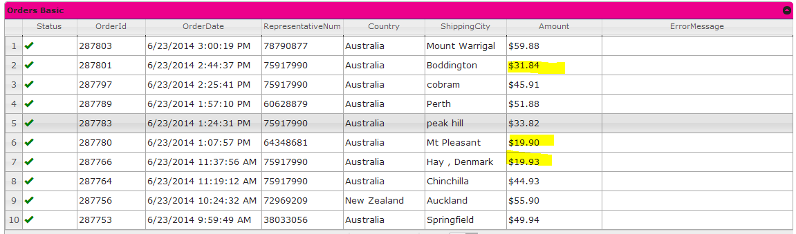
ANZ DCE Update
Direct Delivery Shipping
We do have small orders but average delivery cost is $7 under plan of $9

Slide 26

ANZ DCE Update
Project Husky
End

